Slide 1
Section name: Our Portfolio
Navigation menu: Portfolio
Suggested URL: /portfolio
Main heading:
Explore Our Work
Subheading:
Discover how we transform ideas into engaging digital learning experiences and impactful digital solutions. Explore our work across instructional design, interactive learning, video-based training, and website development.
Supporting text:
At Inspireshift Technologies, we combine creativity, instructional expertise, and technology to develop solutions that make learning engaging and digital experiences effective.
Our portfolio showcases selected work samples demonstrating our capabilities, creativity, and commitment to quality.

Slide 2
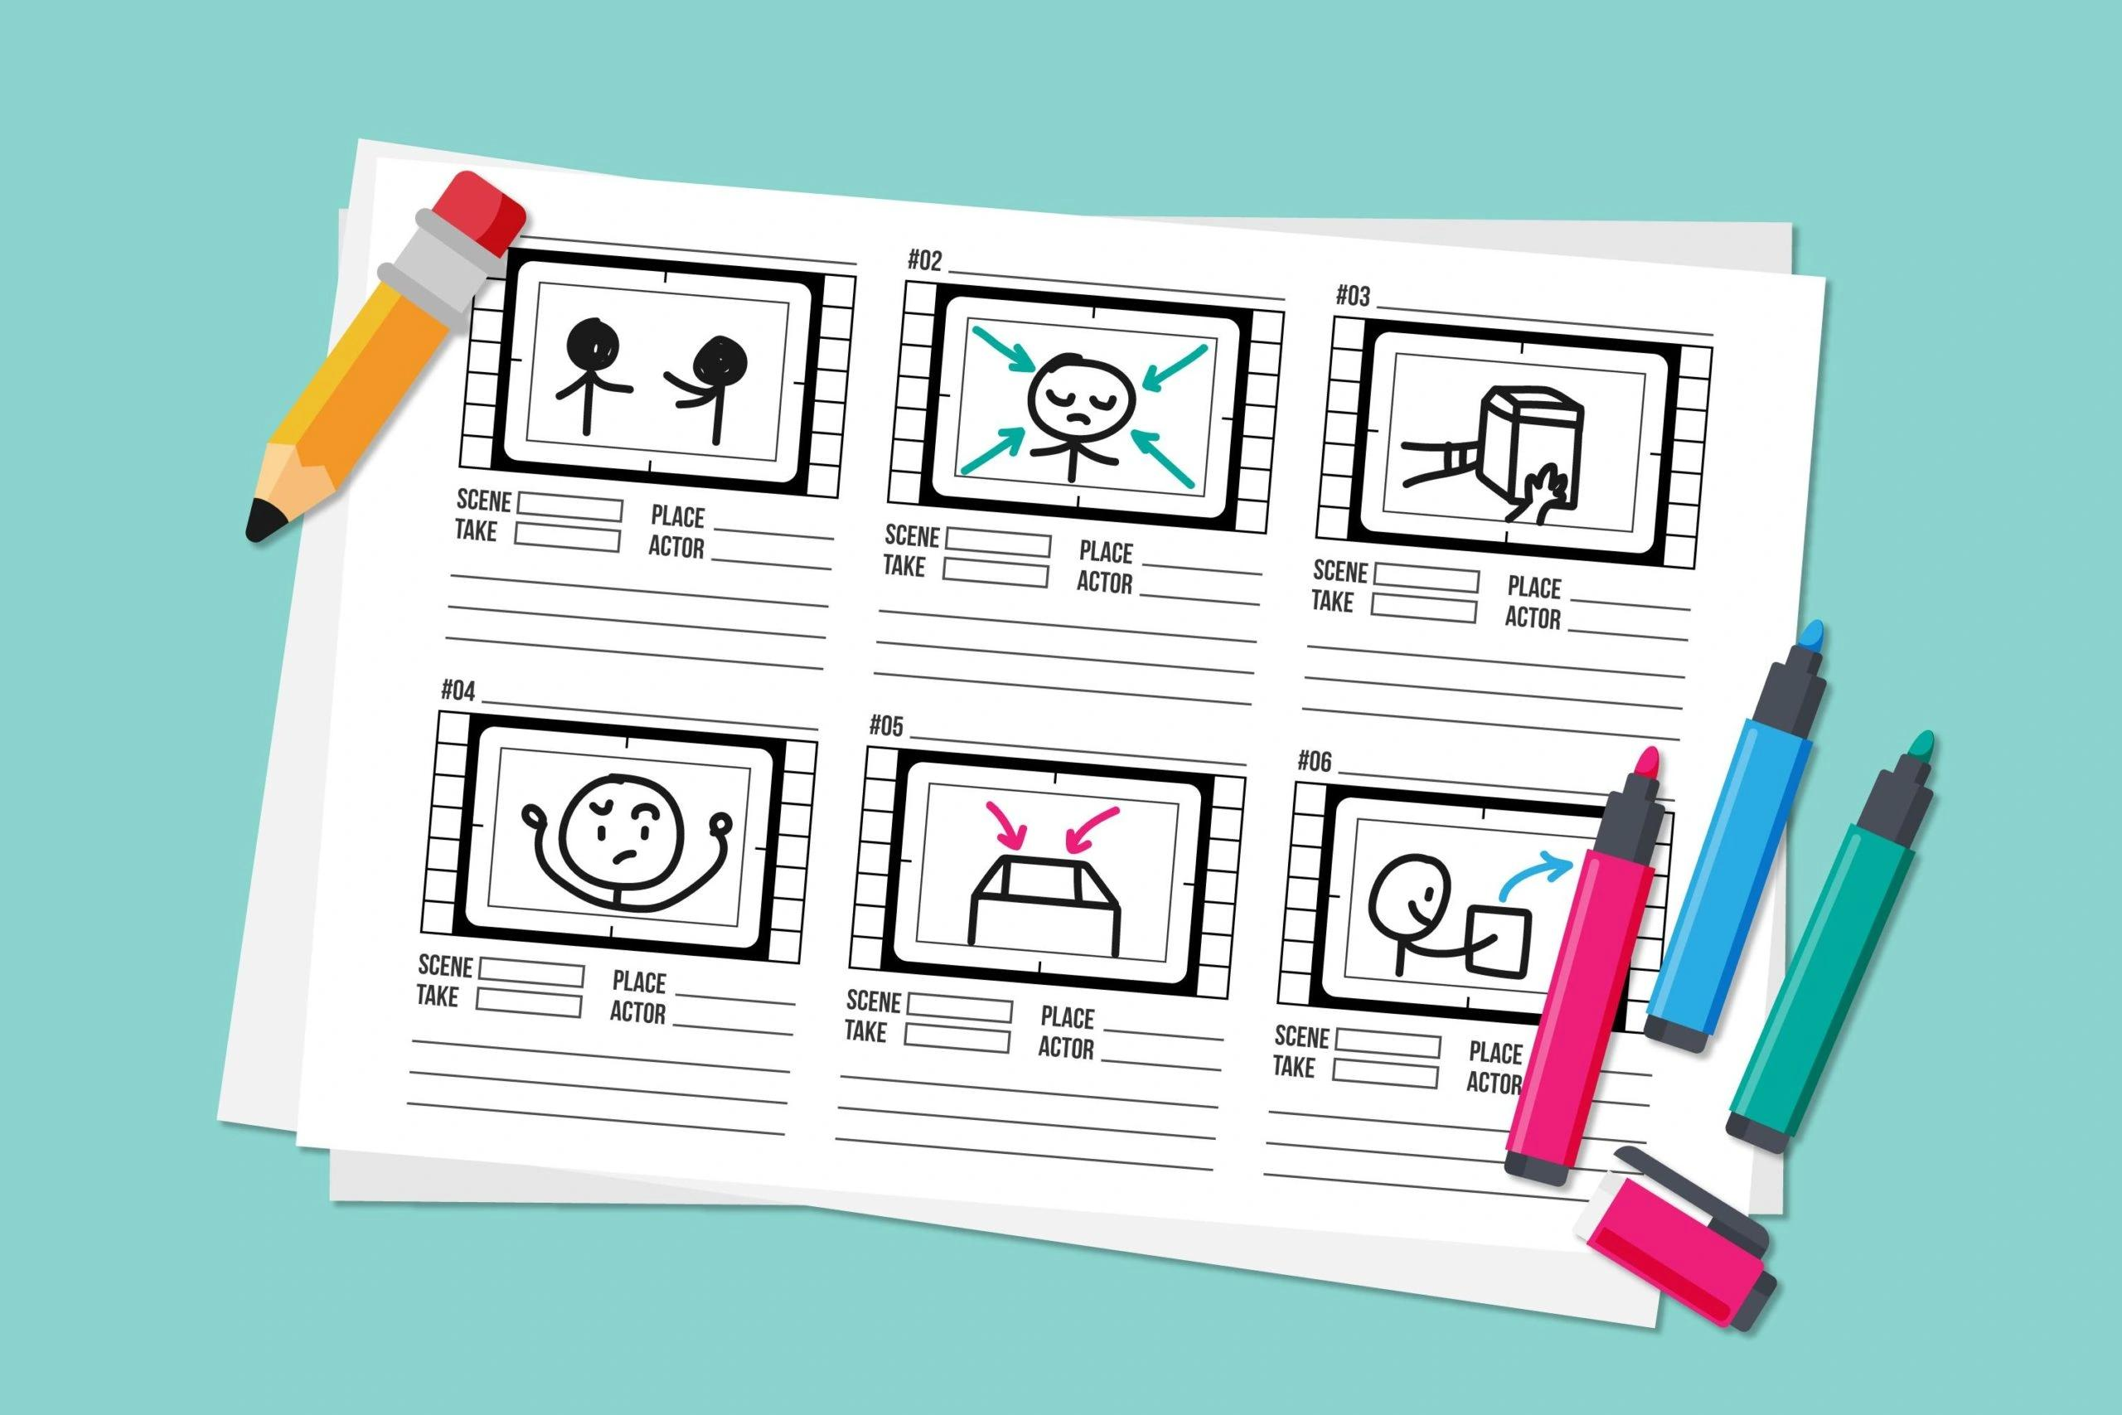
2. Portfolio Categories
Create four portfolio cards in a responsive grid layout.
CARD 01 – STORYBOARD DEVELOPMENT
Title: Storyboards & Instructional Design
Description:
We create structured, learner-focused storyboards that transform complex information into engaging learning experiences. Explore our instructional design strategies, visual concepts, screen layouts, and storyboard samples.
Services represented:
Instructional design strategy
Storyboard development
Content structuring
Visual scripting
Learning experience design
Button: Explore Storyboards

Slide 3

CARD 02 – WEB-BASED TRAINING
Title: Interactive WBT Courses
Description:
Explore our interactive Web-Based Training (WBT) courses designed to deliver engaging, structured, and effective digital learning experiences through interactive content, assessments, and multimedia elements.
Services represented:
Interactive WBT development
E-learning course development
Articulate Storyline-based learning
Interactive assessments
SCORM-based learning solutions
Button: Explore WBT Samples

Slide 4

CARD 03 – VIDEO-BASED LEARNING
Title: Video-Based Learning Solutions
Description:
Discover our video-based learning solutions that simplify complex concepts through engaging visuals, animations, storytelling, and structured educational content.
Services represented:
Educational video development
Animated learning videos
Explainer videos
Training videos
Video-based course development
Button: Explore Video Samples

Slide 5
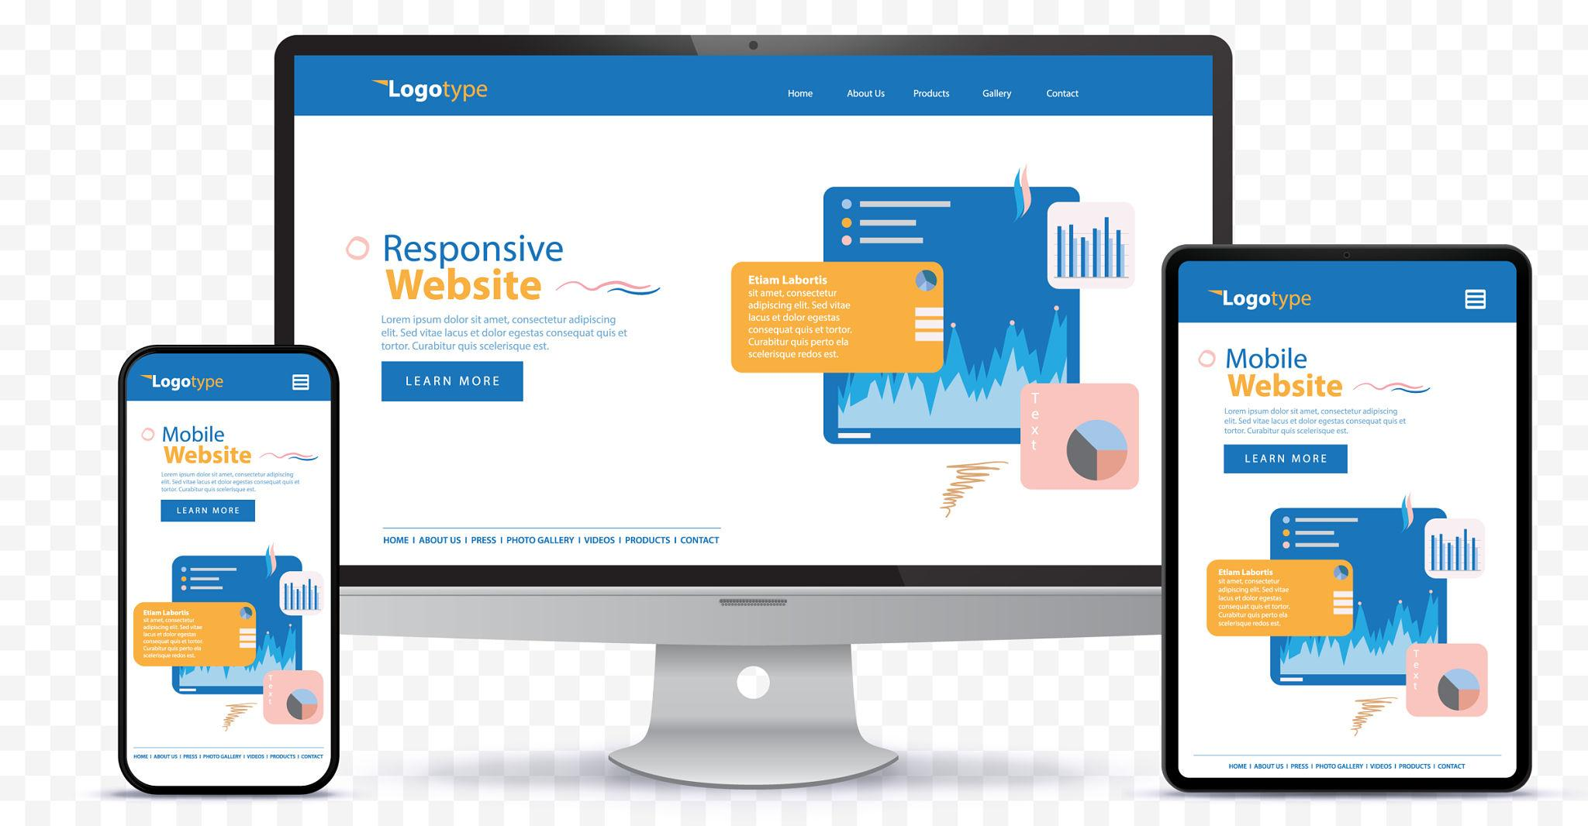
CARD 04 – WEBSITE DESIGN & DEVELOPMENT
Title: Website Design & Development
Description:
Explore our website design and development work, featuring modern interfaces, responsive layouts, user-friendly navigation, and digital experiences built around business requirements.
Services represented:
Website UI/UX design
Responsive website development
Business websites
Landing page development
Website maintenance and enhancements
Button: Explore Website Samples

Slide 6
3. Main Portfolio Call-to-Action
Heading:
Explore Our Complete Portfolio
Description:
Want to see more of what we do? Explore our complete collection of project samples, creative concepts, learning solutions, and website designs in one place.
Button text:
VIEW COMPLETE PORTFOLIO
Button destination: [Complete Portfolio ]
Supporting text:
Explore our collection of Storyboards, WBT Courses, Video-Based Learning Solutions, and Website Designs.

Slide 7
5. Closing Section – Business Enquiry
Heading:
Have a Project in Mind?
Description:
Whether you are looking to develop engaging learning experiences, interactive training courses, educational videos, or a professional website, our team is ready to help turn your ideas into impactful solutions.
Primary button: Let's Discuss Your Project
Secondary button: Contact Us
Link both buttons to the website's existing enquiry/contact page.

Slide 8


